Slide 1

Web Scraping Project: Market Study of Graphics Cards
Roland DENIZOT – Zachary CHENOT – DIA2

Slide 2
Context
Company of hightech and computer equipment
Modify our product line
Identify products on the market
Identify market prices

Slide 3


Websites Scraped

Slide 4
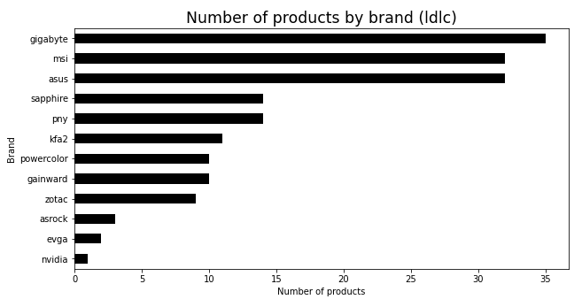
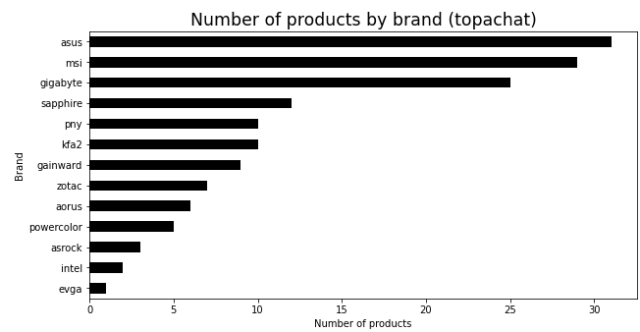
Market Study: Brands
Try to limit the quantity of Asus, MSI and Gigabyte products
Favorize brands such as Sapphire, KFA2, Gainward, Zotac, Aorus => Qualitative brands but less known.
Intel, Inno3D => Not real graphics cards manufacturers, no need to propose much of these products.
Nvidia => Entry level, not customized or improved in a performance purpose. (maybe we could add these for other purpose than gaming and highlight it in our marketing strategy)

Slide 5
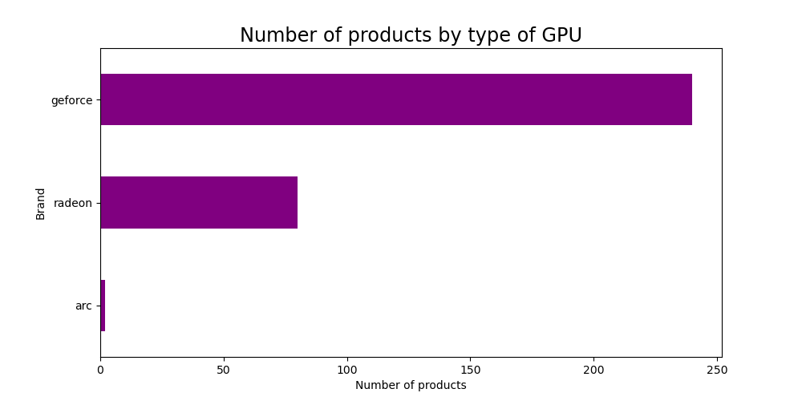
Market Study: GPUs
Prioritize Radeon and Arc (which is only on Topachat) types of GPU.
Keep a good quantity of GeForce because it is well known.
Radeon quality is comparable to GeForce, it could be interesting to propose a significant number of these cards to retrieve this community.
Propose Arc GPU types but limit the quantity => Entry level but consider this opportunity.

Slide 6
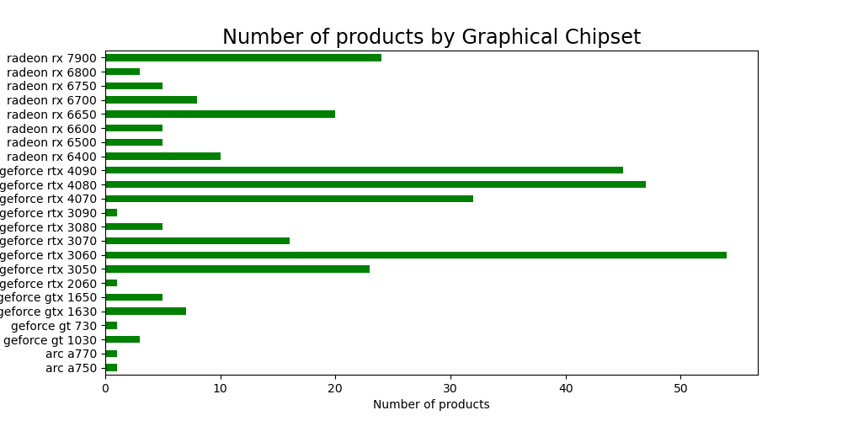
Market Study: Chipsets
Good opportunity on GeForce RTX 3080, 3090 and 3070. Not the latest technology but it keeps efficient, and it could be sufficient for majority if customers (cf prices).
Same for Radeon 6800, 6750 and 6700 + less known cards but very high efficiency.
Propose more entry level cards such as Arc A770, A750, GeForce 2060. For for a public less knowledgeable and needing low performance.
Limit quantity of Geforce RTX 3060, 4080 and 4090.

Slide 7
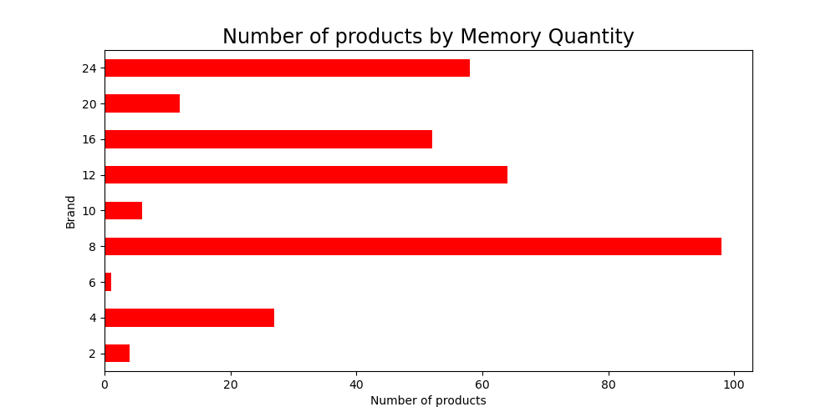
Market Study: Memory
It could be very interesting to complete the offer for 2, 6, 10 and 20 GB of Memory. Quantity of cards proposing these memory sizes are very limited on concurential sites.
None of cards with 14GB of Memory.
Keep proposing cards with 12, 16, 24 GB of memory but adapt the quantity to have equals for each memory size.

Slide 8
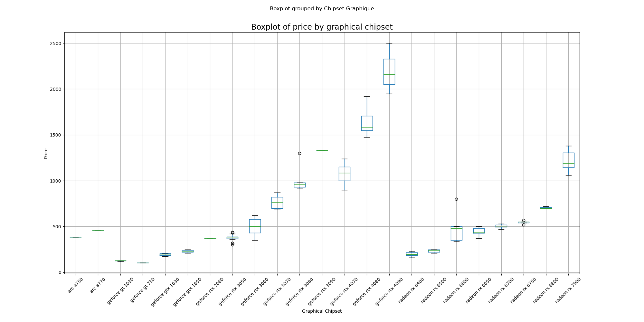
Market Study: Prices by Chipset
Some products have a very high gap of prices, so we need to be very careful on setting up our prices in order to be attractive, particularly on the most expensive ones.
Some other products have not a great range of prices because their variety is not great. It could be interesting to propose more of these products to enlarge the possibilities.

Slide 9
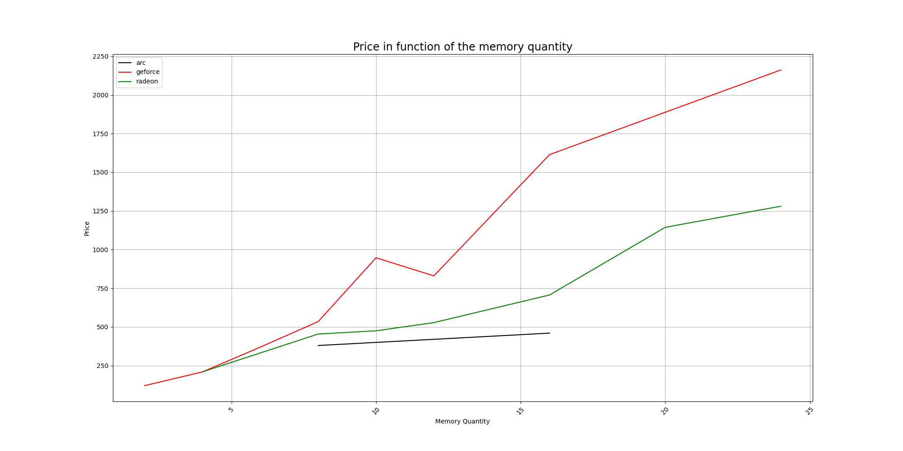
Market Study: Prices by Memory
GeForce cards have higher prices than others, it could be interesting to propose more Radeon because the range seems just as varied but at more attractive prices.
We can see a decrease of the prices for 12GB of memory, it is likely due to a generation change.
For the best cards (with the most memory), the price gap is huge bewteen Radeon and GeForce, so we can try to lower the prices of GeForce or proposing more low price cards.

Slide 10
App

Slide 11
Set up a price

Slide 12
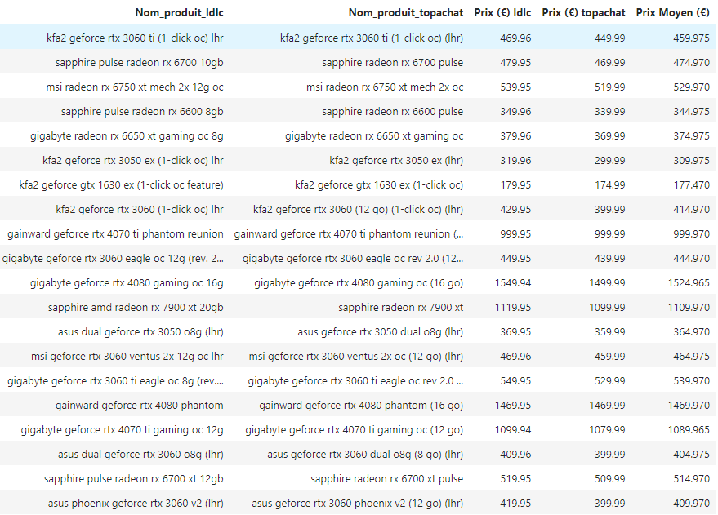
Set up a price
Find the same product on the 2 websites
Generate an accurate price for these products (mean)

Slide 13
Conclusion

